Slide 1


Packets & Protocols (Part 1)

Slide 2
Learning Outcomes
Understanding the basic of computer network & its basic components.
Describe how data is sent through the Internet using packets.
Identify common protocols used on the Internet .
Understanding packets and protocols.

Slide 3
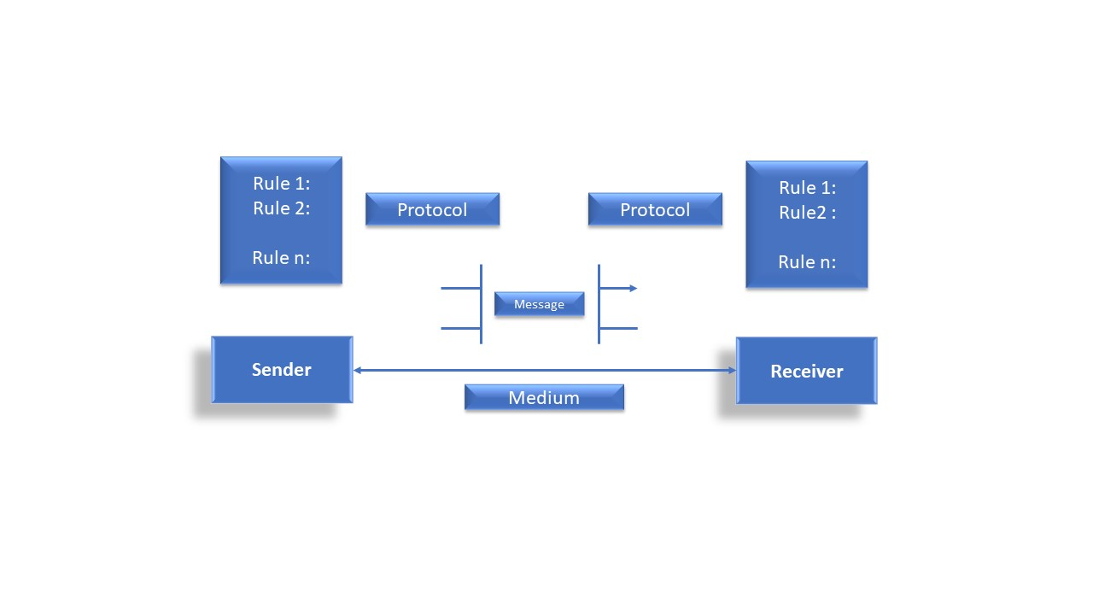
Data Communication:
When we communicate, we are sharing information.
This sharing can be local or remote. Between individuals, local communication usually occurs face to face, while remote communication takes place over distance.
Components: A data communications system has five components :

Slide 4
1. Message: The message is the information (data) to be communicated. Popular forms of information include text, numbers, pictures, audio, and video.
2. Sender: The sender is the device that sends the data message. It can be a computer, workstation, telephone handset, video camera, and so on.
3. Receiver: The receiver is the device that receives the message. It can be a computer, workstation, telephone handset, television, and so on.
4. Transmission medium: The transmission medium is the physical path by which a message travels from sender to receiver. Some examples of transmission media include twisted-pair wire, coaxial cable, fiber-optic cable, and radio waves
5. Protocol: A protocol is a set of rules that govern data communications. It represents an agreement between the communicating devices.

Slide 5
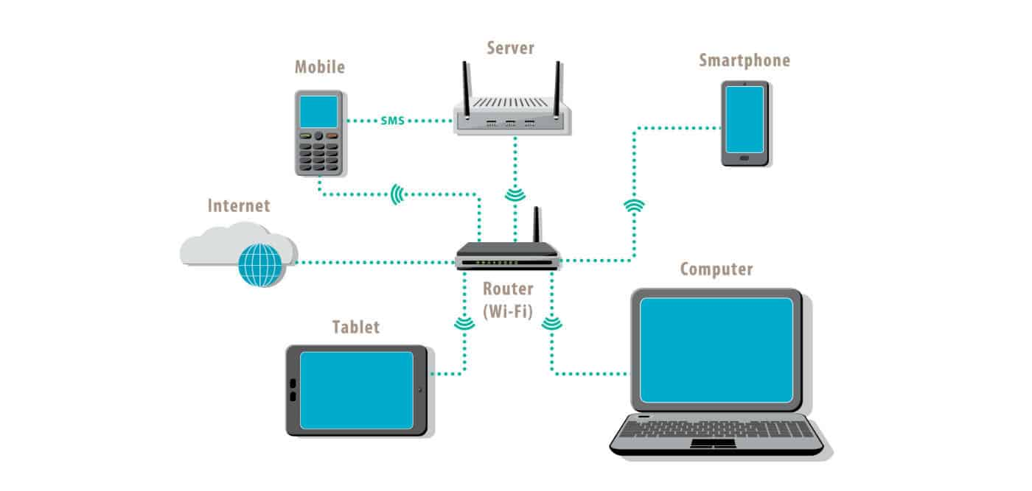
Important Terms
Network:
A network is a group of interconnected devices (such as computers, smartphones, printers, and servers) that communicate with each other to share resources, exchange data, and provide services.
Networks can be as small as a few connected devices in a home or as large as the Internet, which connects millions of devices worldwide.
Example of a Network:
Home Wi-fi Network:
Imagine your home setup. You have several devices like a laptop, a smartphone,
a smart TV, and maybe a printer.
All these devices are connected to a single Wi-Fi router.
This setup creates a small network called a Local Area Network (LAN).

Slide 6
Network Glimpse :

Slide 7
Internet Protocols :
Internet protocols are sets of rules governing communication and data exchange between devices.
They structure data into packets and manage flow control and access.
Various protocols ensure organized communication and data integrity.
Internet Protocols :
An IP address represents an Internet Protocol address.
A unique address that identifies the device over the network.
It is almost like a set of rules governing the structure of data sent over the Internet or through a local network.
An IP address helps the Internet to distinguish between different routers, computers, and websites.
It serves as a specific machine identifier in a specific network and helps to improve visual communication between source and destination.

Slide 8
Key Protocols :
SMTP Manages outgoing email. (SImple Mail Transfer Protocol)
PPP Creates direct connections between devices.
FTP Facilitates file transfers using a client-server model.
SFTP Encrypted file transfers using SSH for secure transmission.
HTTP Transfers hypertext on the internet.
HTTPS Uses SSL/TLS for encryption and authentication.
Telnet Enables local and remote computer connections.
POP3 Retrieves and manages email from a mail server.
IPv4 Uses a 32-bit address system.
IPv6 Uses a 128-bit address system, supports more addresses, enhanced security.
ICMP Sends network messages and diagnoses network issues.
UDP Connectionless and unreliable, used for low latency applications.
IMAP Manages emails on a server, allowing multi-device access.
SSH Secure remote login using encryption.
Gopher An older protocol for file retrieval, now obsolete.

Slide 9
TCP / IP | Ensures correct message delivery.
SMTP | Manages outgoing email
PPP | Creates direct connections between devices.
FTP | Facilitates file transfers using a client-server model.
SFTP | Encrypts file transfers using SSH for secure transmission.
HTTP | Transfers hypertext on the internet.
HTTPS | Uses SSL/TLS for encryption and authentication.
Telnet | Enables local and remote computer connections.
POP3 | Retrieves and manages email from a mail server.

Slide 10
TCP / IP | Ensures correct message delivery.
IPv4 | Uses a 32-bit address system.
IPv6 | Uses a 128-bit address system, supports more addresses, enhanced security.
ICMP | Sends network messages and diagnoses network issue.
UDP | Connectionless and unreliable, used for low latency applications.
IMAP | Manages emails on a server, allowing multi-device access.
SSH | Secure remote login using encryption.
Gopher | An older protocol for file retrieval, now obsolete.

Slide 11
Learning about Packets in Data Transmission
In computer networks, a packet is a container or box that carries data over a TCP/IP network and internetworks.
A packet is the most fundamental logical arbitration of data that is passed over a network .
A packet normally represents the smallest amount of data that can traverse over a network at a single time.
A TCP/IP network packet contains several pieces of information, including the data it is carrying, source destination IP addresses, and other constraints required for quality of service and packet handling.
Packets contain two distinct types of information to reach the destination completely and correctly, namely control information and the data it is carrying.
The control information includes source destination addresses, sequencing format, error detection and correction mechanisms, all of which help to ensure the optimal delivery of data.
The control information usually resides in the header and trailer, encapsulating the user data in between them.

Slide 12
Activity - MCQs
What is the primary purpose of a computer network?
A) To store data permanently
B) To connect computers and enable communication and resource sharing
C) To increase a computer’s processing speed
D) To protect against malware

Slide 13
Activity - MCQs
How is data transmitted over the Internet?
A) As a continuous stream of signals
B) In the form of compressed files
C) In discrete units called packets
D) As physical copies sent via courier

Slide 14
Activity - MCQs
Which protocol is used to transfer hypertext over the Internet?
A) FTP
B) HTTP
C) SMTP
D) SSH

Slide 15
Activity - MCQs
What is an IP address?
A) A security protocol
B) A unique identifier for each device on a network
C) A type of malware
D) A form of data encryption

Slide 16
Activity - MCQs
What is the main function of the TCP protocol?
A) Encrypting data for secure communication
B) Ensuring the reliable transmission of data across a network
C) Managing IP addresses
D) Filtering spam emails

Slide 17
Activity - Answers
B) To connect computers and enable communication and resource sharing
C) In discrete units called packets
B) HTTP
B) A unique identifier for each device on a network
B) Ensuring the reliable transmission of data across a network

